Slide 1

FACIAL EXPRESSION RECOGNITION
Shri Ramdeobaba College of Engineering and Management, Nagpur
Department of Computer Science and Engineering
Session 2022-2023
A Seminar on:

Slide 2
PRESENTED BY:
Group No.: 7
Members:
Harsh Mata (35)
Ved Agrawal (61)
Chirag Bamb (31)
Harshal Dhunde (36)
Project Guide:
Dr. Ramchand Hablani

Slide 3
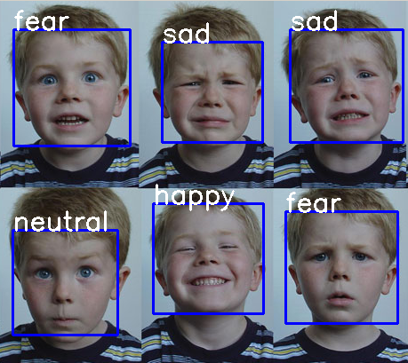
Introduction
Facial Expressions Recognition:
Process of identifying emotions conveyed by human facial expressions.
Various applications (psychology, marketing, security, and entertainment)
In recent years, deep learning techniques have significantly improved the accuracy of facial expression recognition.
Challenges: Handling unbalanced datasets, dealing with occlusions, and ensuring the ethical use of the technology.

Slide 4
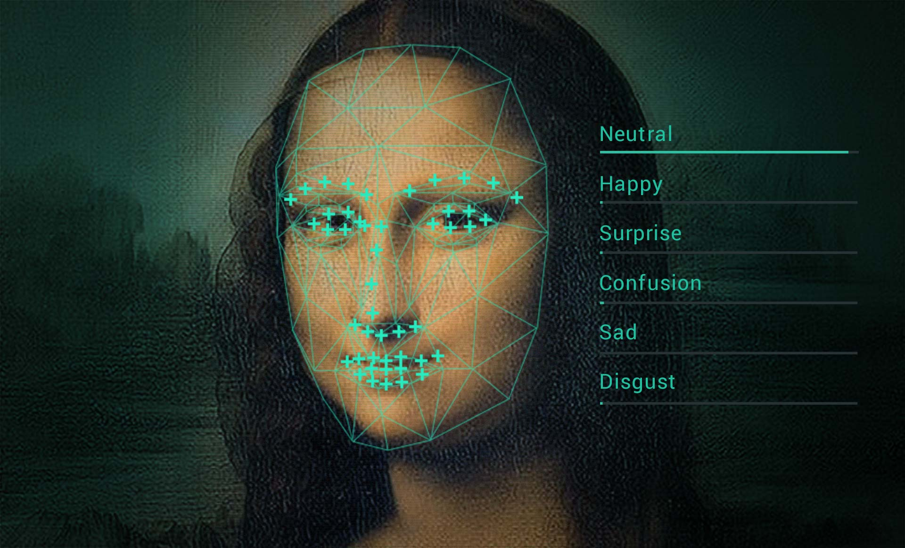
Problem Definition
To build a deep learning model that can detect and classify various facial expressions from images and videos, which poses challenges due to variations in expressions and individual differences, and can be solved by training the model using large datasets of labeled facial images or videos.
Develop an accurate and efficient facial expression recognition system using deep learning
Train a model on large datasets of labeled facial expressions to recognize emotions in real-time
Optimize the model's architecture to improve its accuracy and speed
Address challenges such as handling unbalanced datasets and ensuring ethical use of the technology

Slide 5

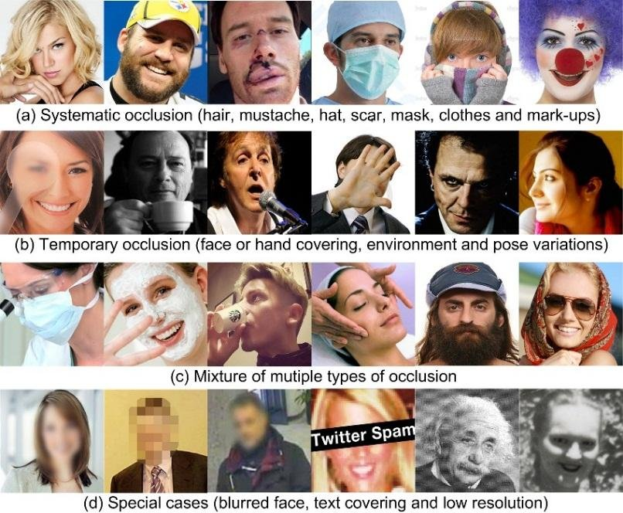
Understanding the problems
01
Traditional computer vision techniques can struggle with subtle differences in expression and variations in lighting, pose, and occlusions.
02
Challenges include handling unbalanced datasets, dealing with occlusions, and ensuring ethical use.
03
Understanding these challenges is crucial for developing accurate and ethical solutions for facial expression recognition.

Slide 6
Literature Survey
Sr. No. | Title | Author | Journal/Source | Findings & Relevance | Research Gap
1 | Deep Facial Expression Recognition: | Shan Li and Weihong Deng | IEEE | Using deep neural networks have increasingly been leveraged to learn discriminative representations for automatic FER | Due to lack of proper dataset unable to train model properly
2 | Facial emotion recognition using deep learning: review and insights | Wafa Mellouka, Wahida Handouzia | Tlemcen university, BP 320, Chetouane Tlemcen 1300, Algeria | In this paper we have a detailed study of all model, their innovations and their problems | This analysis of 2019 so there is some ambiguity

Slide 7
Literature Survey
Sr. No. | Title | Author | Journal/Source | Findings & Relevance | Research Gap
3 | Facial emotion recognition with minimal epochs and the significance of data diversity | Tanoy Debnath, Md. Mahfuz Reza, Anichur Rahman, Amin Beheshti, Shahab S. Band & Hamid Alinejad‑Rokny | https://www.nature.com/articles/s41598-022-11173-0 | Using 4- Layer ConvNet CNN Accuracy highly increased | Large and proper dataset. Illumination problems
4 | Deep Facial Expression Recognition: Challenges, Applications, and Future Guidelines | Muhammad Sajjad, Fath U Min Ullah,, Mohib Ullah, Georgia Christodoulou , Faouzi Alaya Cheikh,, Mohammad Hijji , Khan Muhammad, Joel J.P.C. Rodriguesf | Alexandria Engineering Journal | Deep survey on latest issues and all available datasets and models | Now the shift of deep learning to CNN and GAN

Slide 8
Types Of Neural Networks
Fully-Connected Feed Forward Neural Network - Each Neuron is Connected to every subsequent Layer with no backward connections neurons have activation function which on the given input generates a specific output
Recurrent Neural Network - This is a type of artificial neural network that can process sequential data , recognize patterns and predict the final output
Convolution Neural Network- cnn is a type of neural network that is usually used for image recognition, computer vision , image processing ,image segmentation Input given here is a 2 dimensional matrix and output is in 1 dimension Layers Involved in cnn - 1] Convolutional Layers 2] Polling Layers 3] Fully-connected Layers 4] Normalisation Layers

Slide 9
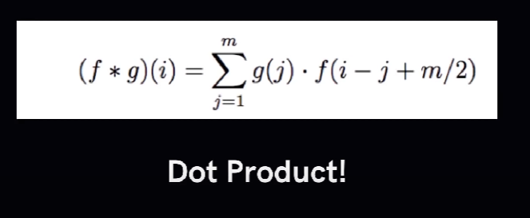
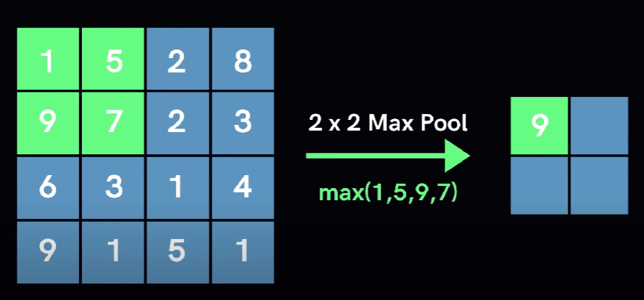
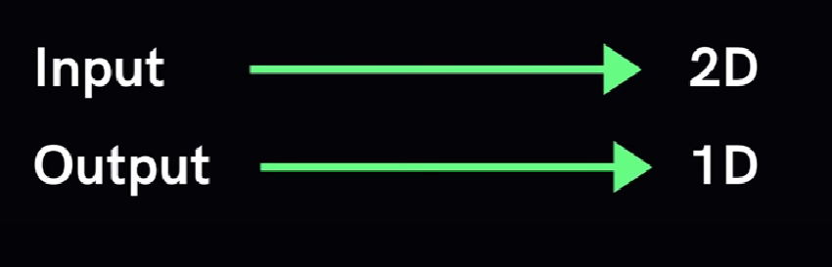
Convolution Neural Network
Allows us to extract visual effects in chunks
Pooling - Reduce The Number of neurons Necessary in subsequent Layers
Two types of polling max-polling and min-polling

Slide 10
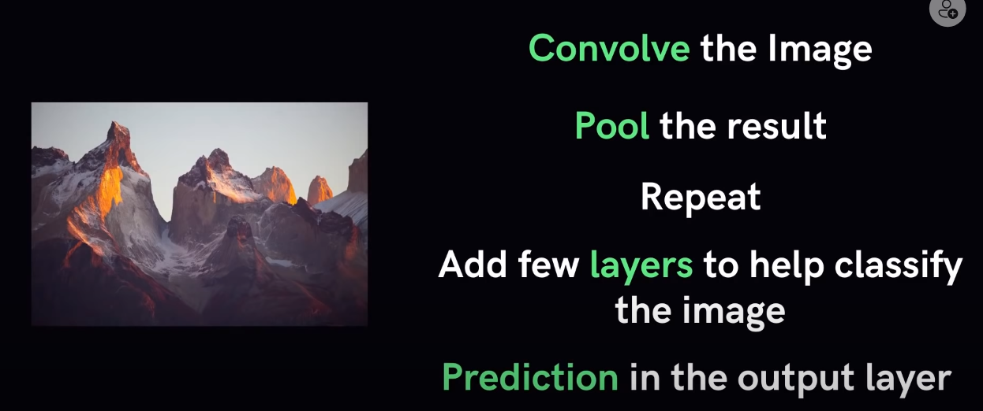
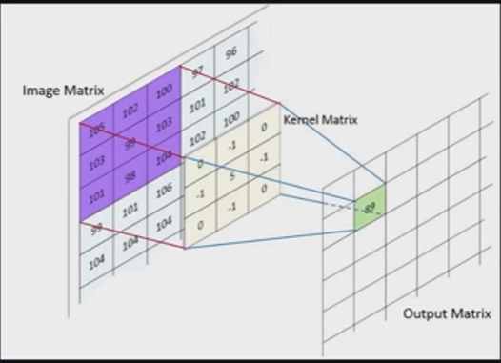

Slide 11

Datasets
Database | Facial Expressions | Sample Details | Type
FER-2013 | Neutral, Sadness, Surprise, Happiness, Fear, Anger, Contempt, and Disgust | 35887 Static Images | Spontaneous
RAF-DB | Angry, Disgust, Fear, Joy, Neutral, Sad, and Surprise | 29672 facial image | Posed
EXP-W | Neutral, Sadness, Surprise, Happiness,Fear, Anger, And Disgust | 91,793 Static Images | Posed
MMI | Happiness, Surprise, Fear, Sadness, Anger, Disgust | 2900 videos and high-resolution still images of 75 subjects | Posed

Slide 12
Database | Facial Expressions | Sample Details | Type
NVIE [57] | happiness, disgust, fear, surprise, sadness, and anger; arousal and valence on a three-point scale | Images of 105, 111, and 112 subjects under right illumination | Spontaneous And Posed
Bosphorus | happiness, surprise, fear, sadness, anger, disgust | 4652 3D images of 105 subjects | Posed
SEMAINE | Five affective dimensions and 27 associated categories | 150 participants, for a total of 959 conversations | Sponteneous
AFEW/SF EW | anger, disgust, fear, happy, sadness, surprise, and neutral | SFEW was extracted from AFEW, 957 video clips and 700 images | Sponteneous

Slide 13




Tech Stack
Python
TensorFlow
Keras
NumPy
OpenCV
Matplotlib

Slide 14
Methodology
Literature Review
Collect Dataset
Pre-process dataset
Train Model
Optimize Algorithm
Implementation
Deploy Model

Slide 15
Natural
Surprise
Disgust
Testing
Framing
Face Detection
Feature Extraction
Fear
Angry
Sad
Happy

Slide 16

Expected Outcomes
Developing a Application for real time detection of facial expression.
Enhance human-machine interaction and improve decision making processes
Real-time Automated Facial Expression Recognition System implemented and tested
Application or website in which this system is integrated.

Slide 17



Future Scope in accuracy
Facial Expression Recognition using 3D images and Stereo images
Facial emotion recognition with minimal epochs and the significance of data diversity

Slide 18


Future Scope in educational department
Face expression recognition in problematic Internet use and excessive smartphone use
PTZ-Camera-Based Facial Expression Analysis for Student Engagement Recognition

Slide 19
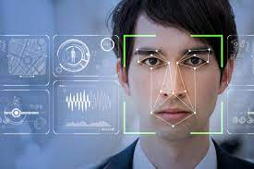
Future Scope in Health care
Facial Expression and Cognitive Function in Patients With Depression
Local attention network for dynamic micro-expression recognition

Slide 20
Project timeline
MAR 1
MID MAR
Till MAR END
APRIL 1-2 WEEKS
APRIL 2-3 WEEKS
MAY WEEK 1
Dataset Collection & Literature survey
Synopsis of the Project
Optimize the model
Real Time Implementation
Deployment and App Integration
Training & testing model on small dataset

Slide 21
References
Datasets :
FER-2013 [21] :- http://www.consortium.ri.cmu.edu/ckagree/
RaFD [41] :- http://www.socsci.ru.nl:8180/RaFD2/RaFD/
RAF-DB [44], [45] :- http://www.whdeng.cn/RAF/model1.html/
ExpW [47] :- http://mmlab.ie.cuhk.edu.hk/projects/socialrelation/index.html/
Research Papers :
Facial emotion recognition using deep learning: review and insights
Facial Expression Recognition Based on Deep Learning Convolution Neural Network: A Review
Emotional face expression recognition in problematic Internet use and excessive smartphone use: task‑based fMRI study
PTZ-Camera-Based Facial Expression Analysis using Faster R-CNN for Student Engagement Recognition
Four‑layer ConvNet to facial emotion recognition with minimal epochs and the significance of data diversity
A Comprehensive Survey on Deep Facial Expression Recognition: Challenges, Applications, and Future Guidelines
A deep prototypical learning with local attention network for dynamic micro-expression recognition
The Relationship Between Facial Expression and Cognitive Function in Patients With Depression
Fine-Grained Facial Expression Analysis Using Dimensional Emotion Model

Slide 22
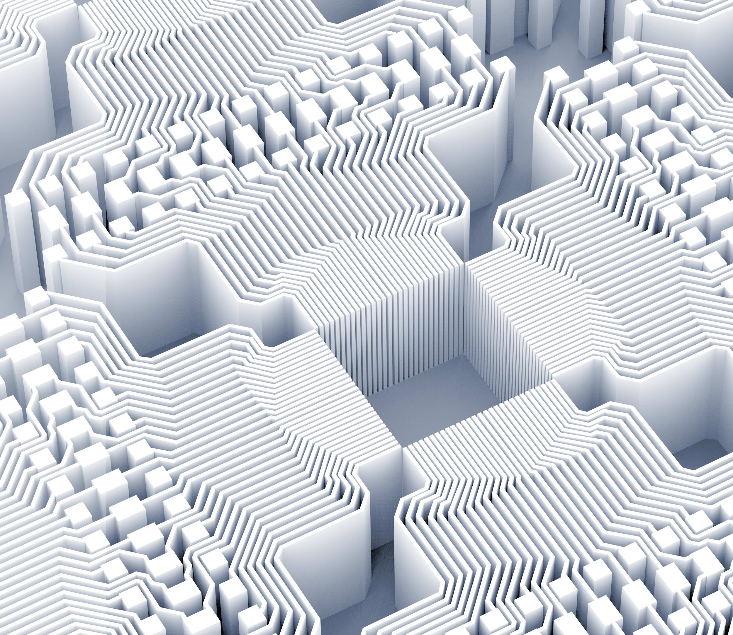
Thank you!

